Slide 1
Quantum Lecture 3
<Bral – lKet> Notation
Two Qubits
Entanglement
EPR Paradox

Slide 2
Agenda for Lecture 3
8:30 – 9:00 RECAP
9:15 – 10:00 2 Videos
10:15 – 11:00 Coderanch
11:00 – 11:45 2 Videos
11:45 – 12:30 Lunch
12:30 – 13:15 MatLab
13:30 – 14:00 Coderanch

Slide 3
8:30 – 9:00 RECAP
Kahoot https://create.kahoot.it/details/9783af2c-32f6-4e4a-8d8d-de90f223a50e
Your Report of Your Own choice
The Qubit
The Vector Space and the basis
Inner products
Geometrical Representation
Heisenbergs Uncertainty Principle

Slide 4
9:15 – 10:00 2 Videos
Lecture 3.1 Bra-Ket Notation
Lecture 3.2 Two Qubits

Slide 5
10:15 – 11:00 Coderanch
Start with the mybinder.org below
https://hub.gke.mybinder.org/user/gubiithefish-ib-ands-on-session-rvo3jzr4/tree/notebook-exercises
10:15 -> Exercise 1 - The HelloWorld
10:30 -> Exercise 2 - [x]-gate operation on Qubit
10:45 ->Exercise 3 - [H]-gate operation on Qubit

Slide 6
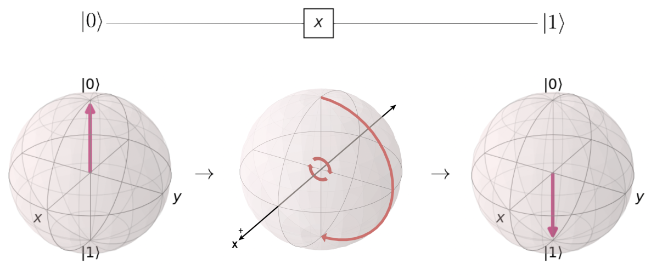
Exercise recaps
What is .measure about
What does the X,Y and Z do as OPERATORS

Slide 7
11:00 – 11:45 2 Videos
Entanglement
EPR Paradox

Slide 8
11:45 – 12:30 Lunch

Slide 9
12:30 – 13:15 MatLab
Exercise 2.1 – Page 36
Exercise 2.2 – Page 36
Exercise 2.3 – Page 36
Exercise 2.4 – Page 36
Example 3.1– Page 41
Example 3.2– Page 44
Example 3.3– Page 45
Example 3.4– Page 47

Slide 10
13:30 – 14:00 Coderanch
Continues with the mybinder.org below
https://hub.gke.mybinder.org/user/gubiithefish-ib-ands-on-session-fzvbsbtj/notebooks/notebook-exercises/1.4%20-%20Gate%20operation%20-%20CNOT-Gate.ipynb
13:30 -> Exercise 4 - [C-NOT]-gate operation on Qubit
13:45 -> Exercise 5 - Code on a quantum computer with cloud platform IBM Q
14:00 -> Lecture 3 ends for today

